Slide 1
WareHouse Management System
WHMS

Slide 2
INTRODUCTION
A food delivery service or an outlet for all the fruits and veggies play a very important role in the place of business as well as the social life of the society.
Where these are the essentials needed by the people of the society who buy them on a day to day basis but dealing with these type of products usually has a very huge potential of risk as they are perishable raw materials.
Where in field of business this requires huge amount of daily forecast and demand for which they can supply wherein getting huge inventory would risk them getting spoilt and which would incur a huge loss for the company.
Our Machine Learning model which would keep a check on the amount of different vegetables and fruits sold and their quantity per day which would give us a raw amount of demand which is created. With which we can alter the amount of supply to a limit by keeping a buffer which depends on the demand of the materials needed by the buyers.

Slide 3
PROBLEM
A food delivery service has to deal with a lot of perishable raw materials which makes it all, the most important factor for such a company is to accurately forecast daily and weekly demand.
Too much inventory in the warehouse means more risk of wastage, and not enough could lead to out-of-stocks - and push customers to seek solutions from your competitors.
The replenishment of the majority of raw materials is done on a weekly basis and since the raw material is perishable, the procurement planning is of utmost importance.

Slide 4
PRODUCED SOLUTION
To check on the given demand we try to implement a model based on Machine Learning which would keep a check on the amount of different vegetables and fruits sold and their quantity per day which would give us a raw amount of demand which is created. With which we can alter the amount of supply to a limit by keeping a buffer which depends on the demand of the materials needed by the buyers.
By use of Machine Learning we can analyze the pattern of how people buy based on various factors and parameters which would help in creating a good model for which the materials or the goods can be acquired by the company.
There in this would help in preventing the waste of these raw materials and would help in acquiring the products needed and would help in the building of the business model and would remove the amount of materials wasted and help in giving the society a better and a more sustainable consumer model.

Slide 5
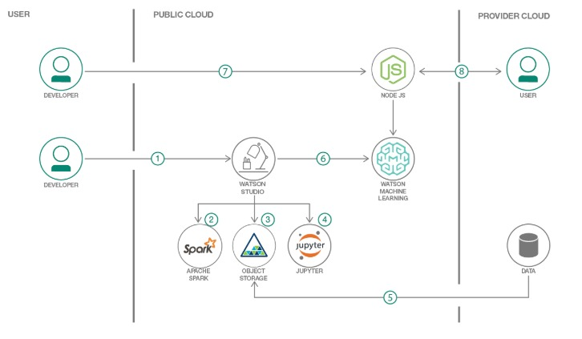
ANALYSIS

Slide 6
ADVANTAGES
By the use of Machine Learning we can analyze the pattern of how people buy based on various factors and parameters which would help in creating a good model for which the materials or the goods can be acquired by the company.
This would help in preventing the waste of these raw materials and would help in acquiring the products needed and would help in the building of the business model and would remove the amount of materials wasted and help in giving the society a better and a more sustainable consumer model.
Efficient.
Accurate.
Precise.

Slide 7
DISADVANTAGES
Where there are many advantages, everything which has advantages comes with some disadvantages also. So here are some few of them,
The major disadvantage would be to implement it on a real life situation and predict its output and the efficiency of the model which is the major criteria in Machine Learning model.
But this disadvantage could be solved by getting a more efficient ML model to get the required output.

Slide 8
APPLICATIONS
In predicting the demand and the pattern of buying.
In predicting the waste generated and minimizing it.
This can be used in a varieties of predicting many parameters in various applications.

Slide 9
FUTURE SCOPE
Further this model can be enhanced to keep a track on the transport their efficiency and various other parameters which enhance the buying patterns and help in reduction of the waste generated.
We can implement this model in all various managing retail stores to get a knowledge on all the products sold and how to get the efficient model in retail stores and get the required efficient output.

Slide 10
THANK YOU

